Slide 1
Se-PS-NPs NTA size and concentration
(a)
0.25% w/w
0.7% w/w
2.7% w/w
Concentration (10⁶ NPs/mL)
(b)
size (nm)
size (nm)
size (nm)
Se-PS-NPs DLS size
Intensity (%)
(c)
size (nm)
size (nm)
size (nm)
Se-PS-NPs NTA and DLS concentration
Concentration (10⁸ NPs/mL)
Figure S8. Additional NTA and DLS size and concentrations distributions for replicates (R1, R2, R3) of 0.25%, 0.7%, 2.7% w/w of Se-PS-NPs; (a) NTA size and concentration distributions. Average size by NTA was 249 ± 17 nm, 253 ± 42 nm and 234 ± 27 nm for 0.25%, 0.7%, 2.7% w/w Se-PS-NPs; (b) DLS size distributions. Average size by DLS was 292 ± 42 nm, 292 ± 34 nm and 302 ± 88 nm for 0.25%, 0.7%, 2.7% w/w Se-PS-NPs. Samples with lower concentrations of nanoparticles increased the standard deviations for DLS data; (c) Comparison between NTA and DLS determined concentrations. Error bars indicate standard deviations.

Slide 2
(a)
(b)
Raw dissolved selenium concentration after 2x dilution in 1% HNO₃ (aq) determined by ICP-MS (ppb)
(c)
(d)
Time (Days)
Time (Days)
Figure S9. Raw dissolved Se ICP-MS data from 35 days leaching test experiments for 10 ppm of Se-PS-MNPs in MHRW; (a) 0.25% w/w, triplicates; (b) 0.7% w/w, triplicates; (c) 2.7% w/w, triplicates; (d) Blanks, duplicates.

Slide 3
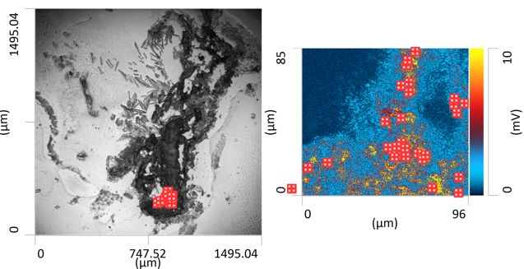
(a)
Microscope image
(b)
1453 cm⁻¹ map
(c)
Full spectra analysis
Unconfirmed Se-PS-MNPs peaks
10 ppm exposure 0.7% w/w Se-PS-MNPs
Confirmed Se-PS-MNPs peaks
O-PTIR
(d)
Negative ion scan
0
50
100
Wavenumber (cm⁻¹)
(e)
Negative ion scan, Se⁻
150
TOF-SIMS
79.80
79.85
79.90
79.95
80.00
(f)
Positive ion scan
(g)
0
50
100
150
Positive ion scan, C₇H₇⁺
90.0
90.5
91.0
91.5
Mass [m/z]
Figure S10. Additional O-PTIR and Nano TOF-SIMS information for Figure 5. (a) Original 10x O-PTIR microscope image of a histological slice of a Daphnia magna exposed to 10 ppm 0.7% w/w Se-PS-MNPs. Emphasis is put on a section of the digestive tract. Red dotted square indicates location of the analysis; (b) O-PTIR mapping of a 96 x 85 µm region of the exposed D. magna at the wavenumber 1453 cm⁻¹ aromatic C-H bending identifiable in polystyrene with point analysis shown by the red crosses at 30 random locations with intensities above 7 mV, with color bar shown on the right side of the image. Mapping done with a scan rate of 100 µm/s at a resolution of 0.2 µm/point with a probe power of 3% and an IR power of 17%; (c) Individual O-PTIR spectrum for each red cross in b) with small circles indicating the presence of identified Se-PS-MNPs by the sharp peaks at 1491 cm⁻¹ and 1453 cm⁻¹ and small triangles indicating non-confirmation of the presence of Se-PS-MNPs; (d) Nano-TOF-SIMS negative ion scan with counts for a m/z range of 0 – 100 g/mol; (e) Nano-TOF-SIMS negative ion analysis with emphasis on counts of Se⁻ at 79.95 g/mol; (f) Nano-TOF-SIMS positive ion scan with counts for a m/z range of 0 – 100 g/mol; (g) Nano-TOF-SIMS negative ion analysis with emphasis on counts of C₇H₇⁺ at 91 g/mol.

Slide 4
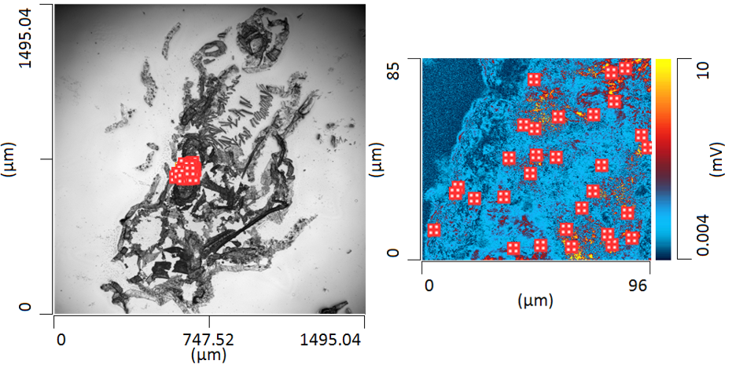
(a)
Microscope image
(b)
1453 cm⁻¹ map
(c)
Full spectra analysis
Unconfirmed Se-PS-MNPs peaks
1 ppm exposure 0.7% w/w Se-PS-MNPs
Confirmed Se-PS-MNPs peaks
O-PTIR
(d)
Negative ion scan
0
50
100
Wavenumber (cm⁻¹)
(e)
Negative ion scan, Se⁻
150
TOF-SIMS
79.80
79.85
79.90
79.95
80.00
(f)
Positive ion scan
(g)
0
50
100
150
Positive ion scan, C₇H₇⁺
90.0
90.5
91.0
91.5
Mass [m/z]
Figure S11. Additional O-PTIR and Nano-TOF-SIMS information for Figure 5. (a) Original 10x O-PTIR microscope image of a histological slice of a Daphnia magna exposed to 1 ppm 0.7% w/w Se-PS-MNPs. Emphasis is put on a section of the digestive tract. Red dotted square indicates location of the analysis; (b) O-PTIR mapping of a 96 x 85 µm region of the exposed D. magna at the wavenumber 1453 cm⁻¹ aromatic C-H bending identifiable in polystyrene with point analysis shown by the red crosses at 30 random locations with intensities above 7 mV, with color bar shown on the right side of the image. Mapping done with a scan rate of 100 µm/s at a resolution of 0.2 µm/point with a probe power of 3% and an IR power of 17%; (c) Individual O-PTIR spectrum for each red cross in b) with small circles indicating the presence of identified Se-PS-MNPs by the sharp peaks at 1491 cm⁻¹ and 1453 cm⁻¹ and small triangles indicating non-confirmation of the presence of Se-PS-MNPs; (d) Nano-TOF-SIMS negative ion scan with counts for a m/z range of 0 – 200 g/mol; (e) Nano-TOF-SIMS negative ion analysis with emphasis on counts of Se⁻ at 79.95 g/mol; (f) Nano-TOF-SIMS positive ion scan with counts for a m/z range of 0 – 100 g/mol; (g) Nano-TOF-SIMS negative ion analysis with emphasis on counts of C₇H₇⁺ at 91 g/mol.

Slide 5

(a)
Microscope image
(b)
1453 cm⁻¹ map
(c)
Full spectra analysis
Unconfirmed Se-PS-MNPs peaks
0.1 ppm exposure 0.7% w/w c-Se-PS-MNPs
Confirmed Se-PS-MNPs peaks
O-PTIR
(d)
Negative ion scan
0
50
100
Wavenumber (cm⁻¹)
(e)
Negative ion scan, Se⁻
150
TOF-SIMS
79.80
79.85
79.90
79.95
80.00
(f)
Positive ion scan
(g)
0
50
100
150
Positive ion scan, C₇H₇⁺
90.0
90.5
91.0
91.5
Mass [m/z]
Figure S12. Additional O-PTIR and Nano-TOF-SIMS information for Figure 5. (a) Original 10x O-PTIR microscope image of a histological slice of a Daphnia magna exposed to 0.1 ppm 0.7% w/w Se-PS-MNPs. Emphasis is put on a section of the digestive tract. Red dotted square indicates location of the analysis; (b) O-PTIR mapping of a 96 x 85 µm region of the exposed D. magna at the wavenumber 1452 cm⁻¹ aromatic C-H bending identifiable in polystyrene with point analysis shown by the red crosses at 30 random locations with intensities above 7 mV, with color bar shown on the right side of the image. Mapping done with a scan rate of 100 µm/s at a resolution of 0.2 µm/point with a probe power of 3% and an IR power of 17%; (c) Individual O-PTIR spectrum for each red cross in b) with small circles indicating the presence of identified Se-PS-MNPs by the sharp peaks at 1491 cm⁻¹ and 1453 cm⁻¹ and small triangles indicating non-confirmation of the presence of Se-PS-MNPs; (d) Nano-TOF-SIMS negative ion scan with counts for a m/z range of 0 – 100 g/mol; (e) Nano-TOF-SIMS negative ion analysis with emphasis on counts of Se⁻ at 79.95 g/mol; (f) Nano-TOF-SIMS positive ion scan with counts for a m/z range of 0 – 100 g/mol; (g) Nano-TOF-SIMS negative ion analysis with emphasis on counts of C₇H₇⁺ at 91 g/mol.

Slide 6
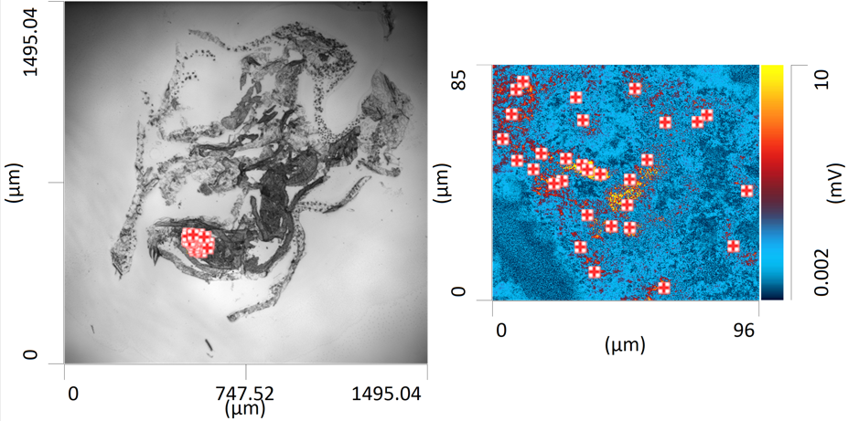
(a)
Microscope image
(b)
1453 cm⁻¹ map
(c)
Full spectra analysis
Unconfirmed Se-PS-NPs peaks
1 ppm exposure 0.7% w/w Se-PS-NPs
Confirmed Se-PS-NPs peaks
O-PTIR
(d)
Negative ion scan
0
50
100
Wavenumber (cm⁻¹)
(e)
Negative ion scan, Se⁻
150
TOF-SIMS
78.80
78.85
78.90
78.95
79.00
(f)
Positive ion scan
(g)
0
50
100
150
Positive ion scan, C₇H₇⁺
90.0
90.5
91.0
91.5
Mass [m/z]
Figure S13. Additional O-PTIR and Nano-TOF-SIMS information for Figure 5. (a) Original 10x O-PTIR microscope image of a histological slice of a Daphnia magna exposed to 1 ppm 0.7% w/w Se-PS-NPs. Emphasis is put on a section of the digestive tract. Red dotted square indicates location of the analysis; (b) O-PTIR mapping of a 96 x 85 µm region of the exposed D. magna at the wavenumber 1453 cm⁻¹ aromatic C-H bending identifiable in polystyrene with point analysis shown by the red crosses at 30 random locations with intensities above 7 mV, with color bar shown on the right side of the image. Mapping done with a scan rate of 100 µm/s at a resolution of 0.1 µm/point with a probe power of 3% and an IR power of 17%; (c) Individual O-PTIR spectrum for each red cross in b) with small circles indicating the presence of identified Se-PS-MNPs by the sharp peaks at 1491 cm⁻¹ and 1453 cm⁻¹ and small triangles indicating non-confirmation of the presence of Se-PS-MNPs; (d) Nano-TOF-SIMS negative ion scan with counts for a m/z range of 0 – 100 g/mol; (e) Nano-TOF-SIMS negative ion analysis with emphasis on counts of Se⁻ at 79.95 g/mol; (f) Nano-TOF-SIMS positive ion scan with counts for a m/z range of 0 – 100 g/mol; (g) Nano-TOF-SIMS negative ion analysis with emphasis on counts of C₇H₇⁺ at 91 g/mol.

Slide 7
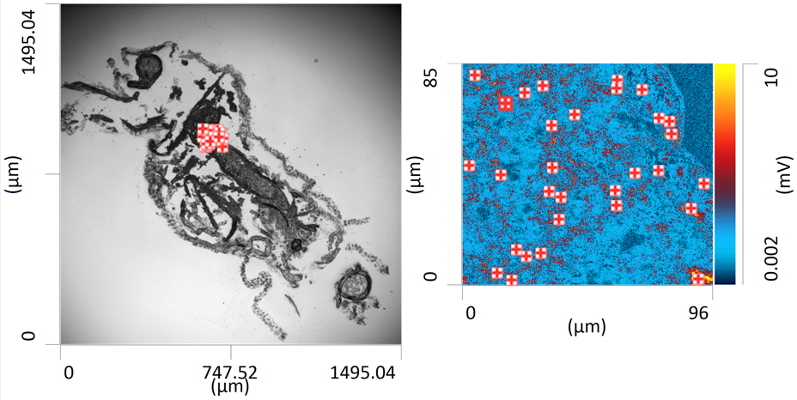
(a)
Microscope image
(b)
1453 cm⁻¹ map
(c)
Full spectra analysis
Unconfirmed Se-PS-NPs peaks
0.1 ppm exposure 0.7% w/w Se-PS-NPs
Confirmed Se-PS-NPs peaks
O-PTIR
(d)
Negative ion scan
0
50
100
Wavenumber (cm⁻¹)
(e)
Negative ion scan, Se⁻
150
TOF-SIMS
79.80
79.85
79.90
79.95
80.00
(f)
Positive ion scan
(g)
0
50
100
150
Positive ion scan, C₇H₇⁺
90.0
90.5
91.0
91.5
Mass [m/z]
Figure S14. Additional O-PTIR and Nano-TOF-SIMS information for Figure 5. (a) Original 10x O-PTIR microscope image of a histological slice of a Daphnia magna exposed to 0.1 ppm 0.7% w/w Se-PS-NPs. Emphasis is put on a section of the digestive tract. Red dotted square indicates location of the analysis; (b) O-PTIR mapping of a 96 x 85 µm region of the exposed D. magna at the wavenumber 1453 cm⁻¹ aromatic C-H bending identifiable in polystyrene with point analysis shown by the red crosses at 30 random locations with intensities above 7 mV, with color bar shown on the right side of the image. Mapping done with a scan rate of 100 µm/s at a resolution of 0.1 µm/point with a probe power of 3% and an IR power of 17%; (c) Individual O-PTIR spectrum for each red cross in b) with small circles indicating the presence of identified Se-PS-MNPs by the sharp peaks at 1491 cm⁻¹ and 1453 cm⁻¹ and small triangles indicating non-confirmation of the presence of Se-PS-MNPs; (d) Nano-TOF-SIMS negative ion scan with counts for a m/z range of 0 – 100 g/mol; (e) Nano-TOF-SIMS negative ion analysis with emphasis on counts of Se⁻ at 79.95 g/mol; (f) Nano-TOF-SIMS positive ion scan with counts for a m/z range of 0 – 100 g/mol; (g) Nano-TOF-SIMS negative ion analysis with emphasis on counts of C₇H₇⁺ at 91 g/mol.

